Slide 1
OSPF
CCNA Exploration Semester 2
Chapter 11

Slide 2
Topics
Background and features of OSPF
Configure basic OSPF
OSPF metric
Designated router/backup designated router elections
Default information originate

Slide 3
Routing protocols
Interior
Exterior
Distance vector
Link state
RIP v1
RIP v2
IGRP
EIGRP
OSPF
IS-IS
EGP
BGP

Slide 4
OSPF background
Developed by IETF to replace RIP
Better metric
Fast convergence
Scales to large networks by using areas

Slide 5
OSPF packets
0x01 Hello establishes and maintains adjacency
0x02 Database Description (DBD) summary of database for other routers to check
0x03 Link State Request (LSR) use to request more detailed information
0x04 Link State Update (LSU) reply to LSR and send new information
0x05 Link State Acknowledgement (LSAck)

Slide 6
OSPF encapsulation
Data link frame header
IP packet header
OSPF packet header
Data
MAC destination address
Multicast 01-00-5E-00-00-05 or 01-00-5E-00-00-06

Slide 7
OSPF encapsulation
Data link frame header
IP packet header
OSPF packet header
Data
IP destination address
Multicast 224.0.0.5 or 224.0.0.6
Protocol field 89

Slide 8
OSPF encapsulation
Data link frame header
IP packet header
OSPF packet header
Data
Type code for packet type (0x01 etc)
Router ID and Area ID

Slide 9
Hello, OSPF packet type 1
Discover OSPF neighbours and establish adjacencies.
Advertise parameters on which two routers must agree to become neighbors.
Elect the Designated Router (DR) and Backup Designated Router (BDR) on multiaccess networks like Ethernet and Frame Relay.

Slide 10
Fields in Hello packet
Type (=1), Router ID, Area ID
Subnet mask of sending interface
Hello Interval, Dead Interval
Router Priority: Used in DR/BDR election
Designated Router (DR): Router ID of the DR, if any
Backup Designated Router (BDR): Router ID of the BDR, if any
List of Neighbors: lists the OSPF Router ID of the neighboring router(s)

Slide 11
Sending Hellos
By default, OSPF Hello packets are sent every 10 seconds on multiaccess and point-to-point segments and every 30 seconds on non-broadcast multiaccess (NBMA) segments (Frame Relay, X.25, ATM).
In most cases, OSPF Hello packets are sent as multicast to 224.0.0.5.
Router waits for Dead interval before declaring the neighbor "down." Default is four times the Hello interval.

Slide 12
Matching
Before two routers can form an OSPF neighbour adjacency, they must agree on three values:
Hello interval,
Dead interval,
Network type (e.g. point to point, Ethernet, NBMA.)

Slide 13
Election
On multi-access networks (Ethernet, NBMA) the routers elect a designated router and a backup designated router
This saves on overhead
Each router becomes adjacent to the designated router and swaps updates with it
If the designated router fails, the backup designated router takes over

Slide 14
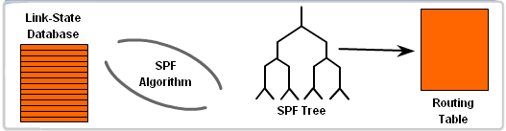
Finding best routes

Slide 15
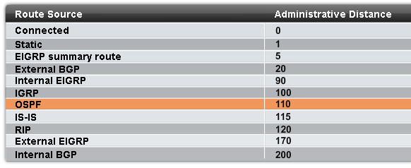
Administrative Distance
Preferred to IS-IS or RIP but not to EIGRP

Slide 16
Configuring OSPF
R1(config)#router ospf 1
R1(config-router)#
The process-id is between 1 and 65535
It does not have to match the process-id on neighbour routers (unlike EIGRP)

Slide 17
Configuring OSPF
Router(config-router)#network 192.168.1.0 0.0.0.255 area 0
Address as usual
Wildcard mask is required (optional for EIGRP), some routers accept subnet mask
We always use a single area 0 for CCNA, this would be the backbone if there are multiple areas.

Slide 18
Choosing the Router ID
Use the IP address configured with the OSPF router-id command.
If the router-id is not configured, use the highest IP address of any of the loopback interfaces.
If no loopback interfaces are configured, use the highest active IP address of any physical interface. The interface must be up. It need not be in a network command.

Slide 19
Show the router ID
show ip protocols (on most routers).
show ip ospf
show ip ospf interface

Slide 20
Loopback address
Highest loopback address is used in preference to a real interface address
A loopback address is a virtual interface and is automatically up, so it cannot fail – this makes it more stable.
Router(config)#interface loopback 0
Router(config-if)#ip address 10.0.0.1 255.255.255.255

Slide 21
OSPF router-id command
Introduced in IOS 12.0(T) and is the first choice for determining router ID.
Router(config)#router ospf 1
Router(config-router)#router-id 172.16.0.1
Many networks still use the loopback address method of assigning router IDs.

Slide 22
Changing router ID
The router ID is fixed when OSPF is configured and given its first network command.
Any loopback addresses or router-id commands should be given before configuring OSPF.
Router#clear ip ospf process can be used, set the ID, then configure OSPF again.
The router may need to be reloaded

Slide 23
Show ip ospf neighbor
Neighbor ID | Pri | state | Dead Time | Address | Interface
10.3.3.3 | 1 | FULL/ | 00:00:30 | 192.168.10.6 | Serial0/1
10.2.2.2 | 1 | FULL/ | 00:00:33 | 192.168.10.2 | Serial0/0
Of neighbour
OSPF priority
On this router
Fully adjacent

Slide 24
Other show commands
show ip protocols
show ip ospf
show ip ospf interface
Show ip route

Slide 25
Summary?
OSPF does not summarise to class boundaries by default.

Slide 26
OSPF metric
The OSPF specification says that cost is the metric, does not say how cost is found.
Cisco uses bandwidth
Cost = 10⁸ = 100,000,000
bandwidth bandwidth
Then finds cumulative cost for all links on a path.

Slide 27
Standard costs
Interface type | 10⁸/bps = Cost
Fast Ethernet and faster | 10⁸/100,000,000bps = 1
Ethernet | 10⁸/10,000,000bps = 10
E1 | 10⁸/2,048,000bps = 48
T1 | 10⁸/1,544,000bps = 64
128 Kbps | 10⁸/128,000bps = 781
64 Kbps | 10⁸/64,000bps = 1562
56 Kbps | 10⁸/56,000bps = 1785

Slide 28
Faster than 100 Mbps
By default, the cost metric for all interfaces operating at 100Mbps or more is 1.
This uses the reference bandwidth of 100Mbps.
To distinguish between links of higher bandwidths, configure all routers in the area e.g.
auto-cost reference-bandwidth 1000
This would multiply costs by 10 and allow for faster bandwidths to have costs below 10.

Slide 29
Serial link bandwidths
Serial links often have a default bandwidth of T1 (1.544 Mbps), but it could be 128 kbps.
This may not be the actual bandwidth.
show interface will give the default value.
show ip ospf interface gives the calculated cost.
Give it the right bandwidth.
Router(config-if)#bandwidth 64

Slide 30
Configure the cost directly
Alternative to configuring the bandwidth:
Configure the cost directly.
R1(config)#interface serial 0/0
R1(config-if)#ip ospf cost 1562
Configure cost if there are non-Cisco routers in the area that calculate costs in different ways.

Slide 31

Point to point network
Only two routers on network
They become fully adjacent with each other

Slide 32
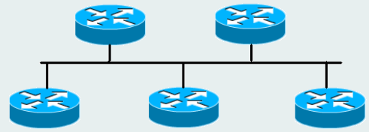
Multiaccess networks
Networks where there could possibly be more than 2 routers, e.g. Ethernet, Frame Relay.
These have a method of cutting down on adjacencies and the number of updates exchanged.
5 routers:
10 adjacencies?

Slide 33
Multiaccess network
Not efficient if they every router becomes fully adjacent to every other router
Designated router (DR) becomes fully adjacent to all other routers
Backup designated router (BDR) does too – in case designated router fails

Slide 34
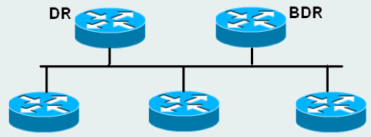
Multiaccess
All routers send LSUs to DR and BDR but not to other routers
Use multicast address 224.0.0.6
DROther
DROther
DROther

Slide 35
Multiaccess
DR then sends LSUs to all routers
Use multicast address 224.0.0.5

Slide 36
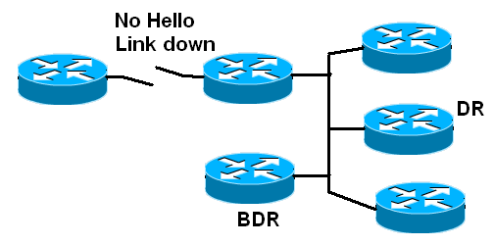
Router detects change
A router knows that a link is down if it does not receive a timed Hello from a partner

Slide 37
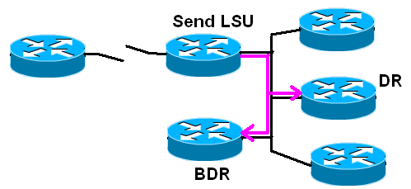
Send update
The router sends a LSU (link state update) on multicast 224.0.0.6 to DR/BDR

Slide 38
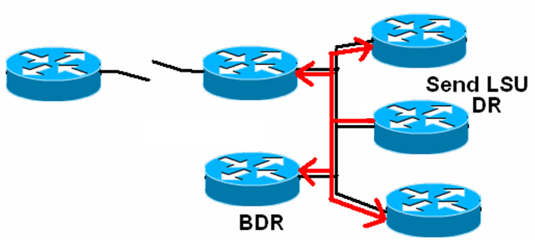
Update all routers
DR sends to 224.0.0.5, all OSPF routers
BDR does not send unless DR fails

Slide 39
Recalculate routing table
Each router sends LSAck acknowledgement
Waits for hold time in case link comes straight back up
Runs SPF algorithm using new data
Updates routing table with new routes

Slide 40
OSPF network types
Network type | Characteristics | DR election?
Broadcast multiaccess | Ethernet, token ring, FDDI | Yes
Nonbroadcast multiaccess | Frame relay, X.25, ATM | Yes
Point to point | PPP, HDLC | No
Point to multipoint | Configured by administrator | No
Virtual link | Configured by administrator | No

Slide 41
DR/BDR election
Happens when routers first discover each other using Hellos.
Router with highest priority becomes DR, next highest becomes BDR.
If they have the same priority then the highest router ID becomes DR, next highest becomes BDR.
By default all routers have priority 1

Slide 42
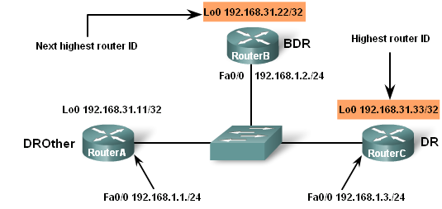
Election where same priority

Slide 43
Add a router
An election has taken place and a DR and BDR have been chosen.
Now add another router with a higher priority. It will not become DR if there is already a DR.
To make sure that a certain router becomes DR:
  Give it the highest priority
  Switch it on first

Slide 44
OSPF states
Down
Init (after receiving hello)
Two-way (election here)
ExStart (decide who initiates exchange)
Exchange (swap summary database)
Loading (link state requests and updates)
Full adjacency (know the same topology)

Slide 45
DROther routers
Routers that are not elected as DR or BDR are called DROther.
They become fully adjacent with DR and BDR.
They stay in 2-way state with each other.

Slide 46
Priority
Router(config-if)#ip ospf priority {0 - 255}
To force an election:
Shut down the interfaces
Bring them up again, chosen DR first, chosen BDR second.
The DR should be a router with plenty of processing power.

Slide 47
Propagate static route
R1(config-router)#default-information originate
In routing table
O*E2 0.0.0.0/0 [110/1] via 192.168.10.10, 00:05:34, Serial0/0/1
E2 means this is an OSPF External Type 2 route.
The cost will stay the same as it is propagated.
Type 1 would increase its cost at each router.

Slide 48
Changing intervals
Router(config-if)#ip ospf hello-interval seconds
Router(config-if)#ip ospf dead-interval seconds
This needs to be done on both partners in an adjacency.
The adjacency is broken when one router is changed.

Slide 49
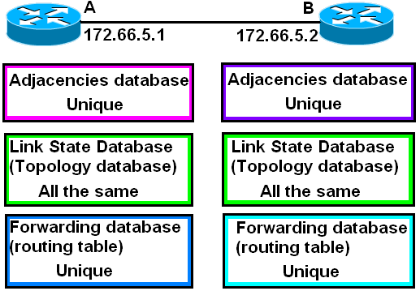
Databases

Slide 50
Comparing routing protocols
Link state
Sends LSA updates – low bandwidth use after initial flooding
Complex algorithm – powerful processor
Three databases – large memory
No loops
Distance vector
Broadcasts whole routing tables – high bandwidth use
Simple algorithms – little processing
One table – little memory
Can have loops

Slide 51
The End

